Slide 1

DEPARTMENT OF ELECTRONICS AND COMMUNICATION ENGINEERING
CMR TECHNICAL CAMPUS
UGC AUTONOMOUS
KANDLAKOYA (V), MEDCHAL ROAD , HYDERABAD 501401
Mini Project Presentation On
BUILDING AN ARDUINO-POWERED ECG MONITOR AND ALERTING SYSTEM
PROJECT GUIDE :
PRESENTED BY :
BATCH NO: A4
1. GOPAGONI DEEPIKA (217R1A0420)
2.THADKAPALLY CHARANKUMAR (217R1A0457)
3. BOORA SREEJA (217R1A0407)
4. GARLAPA TI KARTHIKEYA REDDY (217R1A0419)
Name:-Dr.Sudha Arvind
Designation:- Associate professor
1

Slide 2
OVERVIEW
Introduction
Importance of the Project
Advantages
Applications
Software and Hardware
Literature Survey
1) Introduction
2) History
7. Problem Formulation :
1) Proposed solution.
2) Existing solution.
8. Theoretical Modelling

Slide 3
9. Experimental observations
10. Software and Hardware
Results and flow chart.
Conclusion and Scope for Future Work.
References.
Demo Video.
Hardware project with kit functioning.

Slide 4
INTRODUCTION:
Heart diseases are becoming a big issue for the last few decades Therefore, heart disease cannot be taken lightly. By analyzing or monitoring the ECG signal at the initial stage this disease can be prevented.
So in this project we make use of AD8232 ECG module to monitor the ECG signal of the patient & Arduino with ECG Graph.APR33A3 voice module is used for voice alert & GSM module is used for SMS alert. ESP8266 WI-FI module is used for monitoring the ECG signal in to the thingspeak cloud along with date and time.

Slide 5
IMPORTANCE OF THE PROJECT:
It is a non-invasive and painless procedure that involves attaching electrodes to the skin to record the heart’s electrical signals.
Design a patient health monitoring system using AD8232 ECG sensor & wireless monitoring using IOT thingspeak technology.
Alert in abnormal condition using GSM and voice module.
This allows them to early detect and promptly treat patients’ conditions, especially in the critical care ward. Real-time ECG monitoring can also be used for remote monitoring of patients.

Slide 6
ADVANTAGES:
Cost-effective, making it accessible to a wide range of users.
Remote Monitoring
Real-time Alert
Continous Monitoring
Data Analysis
Integration of Voice Communication

Slide 7
APPLICATIONS:
Homes
Old age homes
Hospital
Rural areas

Slide 8
SOFTWARE AND HARDWARE USED
Software
Arduino software:
Arduino is a prototype platform (open-source) based on an easy-to-use hardware and software.
It consists of a circuit board, which can be programed and a ready-made software called Arduino IDE (Integrated Development Environment), which is used to write and upload the computer code to the physical board

Slide 9
ARDUINO IDE INSTALLATION
Step 1: First we must have our Arduino board and a USB cable.
Step 2: Download Arduino IDE Software.We can get different versions of Arduino IDE from the Download page on the Arduino Official website.We must select our software, which is compatible with your operating system (Windows, IOS, or Linux). After file download is complete, unzip the file.
Step 3: Power up your board. Connect the Arduino board to your computer using the USB cable. The green power LED(labeled PWR) should glow.

Slide 10
Step 4: Launch Arduino IDE.
After our Arduino IDE software is downloaded, we need to unzip the folder. Inside the folder, we find the application icon with an infinity label (application.exe). double-click the icon to start the IDE.
Step5:Open your project once the software starts,you have two options
1.Create a new project
2.Open an existing pro
Step 6: Select your Arduino board.
Go to Tools -> Board and select our board.
Step 7: Select serial port and upload the program.

Slide 11
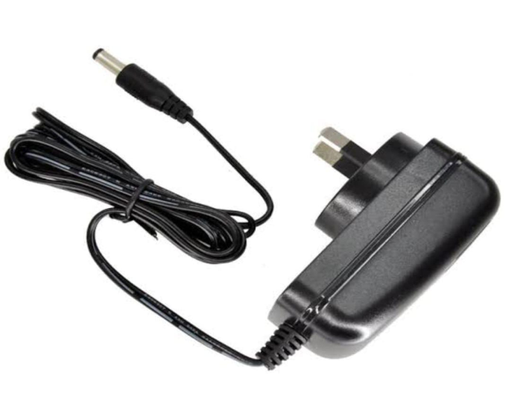
HARDWARE
Power supply:
Adapter:
The 5V adapter is used to provide the power supply of the Arduino UNO
Fig1:Adapter

Slide 12
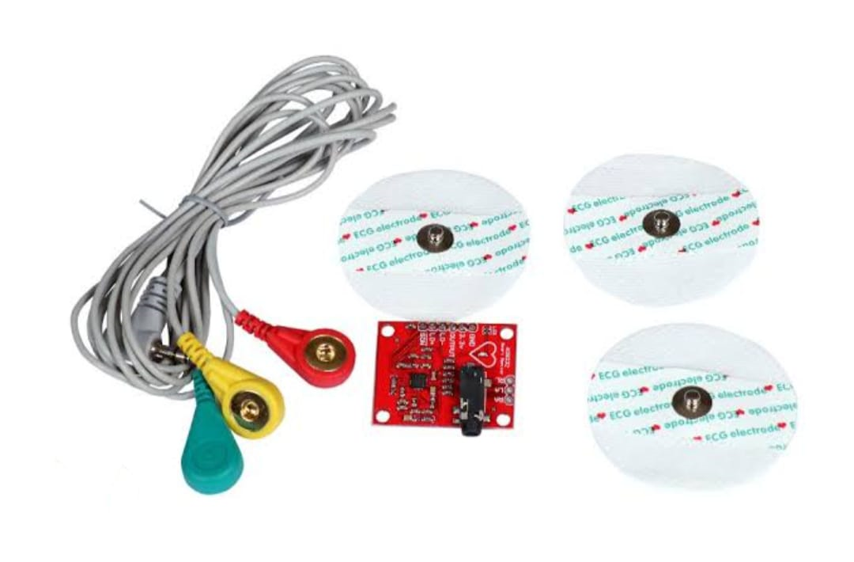
AD8232 ECG Sensors:
This sensor is a cost-effective board used to measure the electrical activity of the heart. This electrical activity can be charted as an ECG or Electrocardiogram and output as an analog reading.
The AD8232 is an integrated signal conditioning block for ECG and other biopotential. It is designed to extract, amplify, and filter small biopotential signals in the presence of noisy conditions,such as those created by motion or remote electrode placement.
Fig2:AD8232 ECG sensor ,cable & electrodes

Slide 13
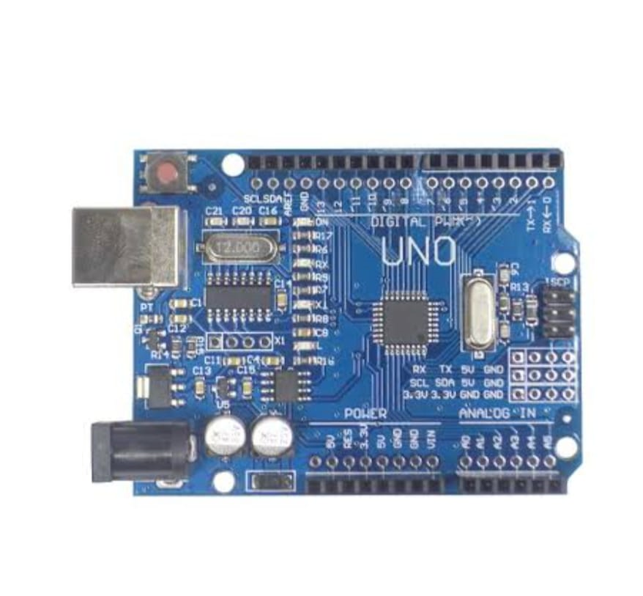
Arduino UNO:
The Arduino Uno is a micro controller board which has ATmega328 from the AVR family. There are 14 digital input/output pins, 6 Analog pins and 16MHz ceramic resonator.
USB connection, power jack and also a reset button is used. Its software is supported by a number of libraries that makes the programming easier.
Fig3:Arduino Uno board

Slide 14
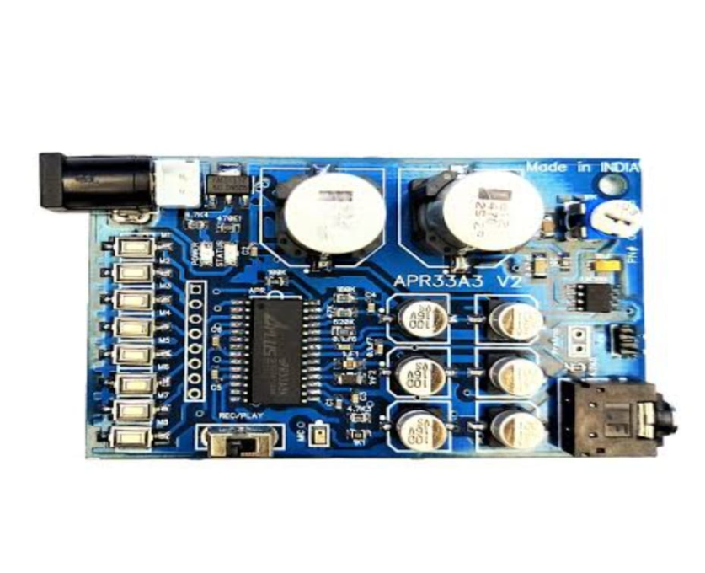
APR33A3 Voice module:
Total 11 minutes of recording time each channel(M0toM7) having 1.3 minutes of recording time.
Singlechip ,high quality voice recording and play back solution,low cost.
When the system detects any abnormal condition, it will give the voice alert through speaker.
Fig4:APR33A3 voice module

Slide 15
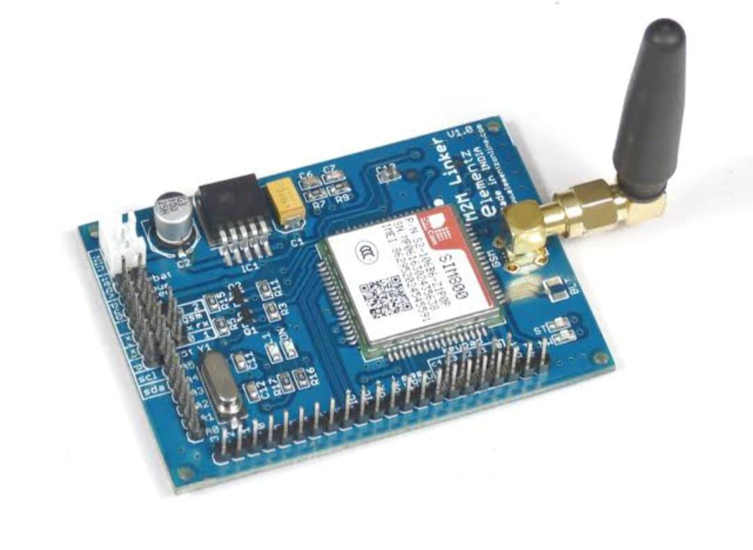
GSM:
GSM is a mobile communication modem; it is stands for global system for mobile communication (GSM).
When the system detects any abnormal condition, it will send the alert SMS to the predefine mobile number via GSM.
Fig5:GSM module

Slide 16
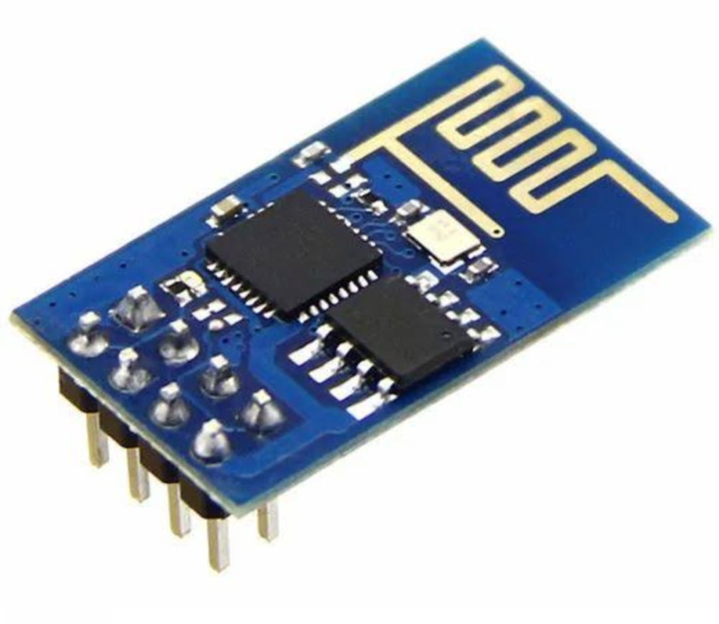
ESP8266 WI-FI Module:
The ESP8266 Wi-Fi Module is a self-contained SOC with integrated TCP/IP protocol stack that can give any microcontroller access to your Wi-Fi network.
The ESP8266 module is an extremely cost effective board with a huge, and ever growing, community.
Fig6:ESP8266 wi-fi module

Slide 17
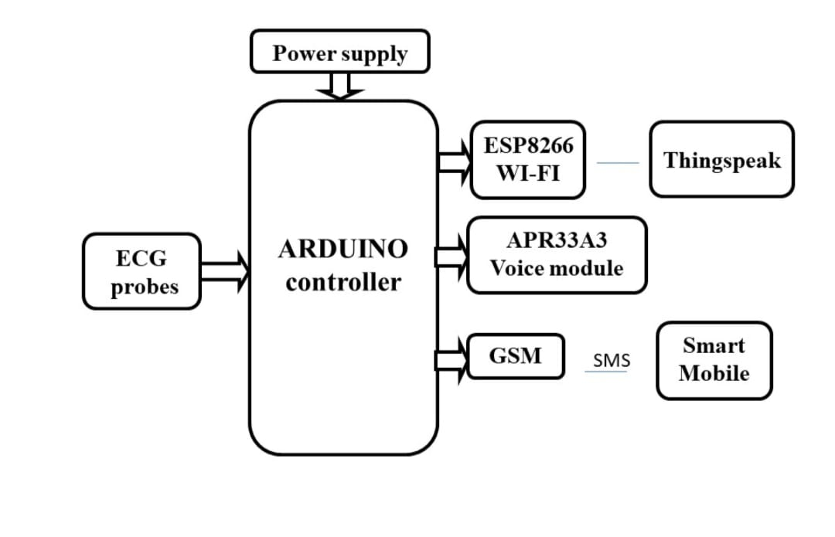
BLOCK DIAGRAM
Fig7:Block diagram

Slide 18
FLOW CHART
start
Initialize System
Power Supply Distributes Power
Collect ECG Data & send data to Arduino Uno
Process ECG Data
NO
Abnormal ECG
Yes
Activate voice and SMS
Esp8266 wi-fi module & GSM
Send data to Thingspeak
Is alert condition Met
Voice from speaker & SMS to predefined mobile number
Fig8:Flow chart
End

Slide 19
LITERATURE SURVEY
S .No | Name of the Author | Paper Title | International Journal/conference | Month/year | Description | Limitations
1. | Sohit Agarwal, Devashish Dasaya | Iot-Based ECG Montoring System for Health Care Applications | Mathematical Statistician and Engineering Applications | Dec/20022 | Internet of Things(IOT) –enchanced ECG monitoring system that can either send data to a server in real time and can be seen in using Smartphone | GSM module will be integrated into the system&allowing for phone calls and SMS messaging to be made
2. | Mamoona Humayun (2020) | IOT-Based Secure& Energy efficient Scheme for E-health Applications. | Indian Journal of Science and Technology | Aug/2020 | A standardised method of transmitting patient data across the Internet of Things in E-health contexts within hospitals | Insecure and call for the implementation of specialized, lightweight security measures due to limitations in available resources.

Slide 20
S . no | Name of the Author | Paper Title | International Journal/conference | Month/ year | Description | Limitation
3. | S. SheebaRani, JafarA.Alzubi,S.K.Lakshamanaprabu,Deepak Gupta,Ramachandran Manikandan | Optimal users secure data transmission on the internet of healthcare things(IOHT) with lightweight block ciphers | Multimedia Tools and Applications (Springer) | May/ 2019 | Research into the challenges of data gathering in IoT -based healthcare apps has led to the development of a novel healthcare data secure method that ensures the privacy&security of patient records. | Its execution time is far high than that of other cypher algorithms and the model utilized to create shares in the system
4. | Sarada Prasad Gochhayat, Chhagan Lal, Lokesh Sharma, D. P. Sharma, Deepak Gupta, Jose Antonio Marmolejo Saucedo, Utku Kose | Reliable and secure data transfer in IoT networks | Wireless Networks(Springer) | Nov/ 2019 | A healthcare CPS that is secure.SLA compliant, and energy efficient to ensure the confidentiality of all communications between patients and healthcare providers and the timely fulfillment of all user demands | Data size will be reduced to make efficient use of network resources, and future research

Slide 21
PROBLEM FORMULATION
PROPOSED SOLUTION:
The ECG monitoring system presented combine electrocardiogram(ECG) sensing technology with a voice module,ESP8266 microcontroller,ThingSpeak cloud platform,and GSM communication capability.
The ECG sensor captures heart activity, which is processed by the ESP8266 microcontroller and transmitted to the ThingSpeak cloud platform for storage and analysis.
If there is any Abnormalities in ECG readings trigger alerts via the GSM module, allowing for immediate intervention.
Additionally, the system in corporates a voice module to facilitate two-way communication between patients and healthcare providers
01-06-2024

Slide 22
EXISTING SOLUTION:
Internet of Things (IoT)-enhanced electrocardiogram (ECG) monitoring system that can either send data to a server in real time or create an ECG graph that can be seen on a Smartphone with an accompanying app.
The patient's current temperature, humidity, and heart rate are all shown in the app.

Slide 23
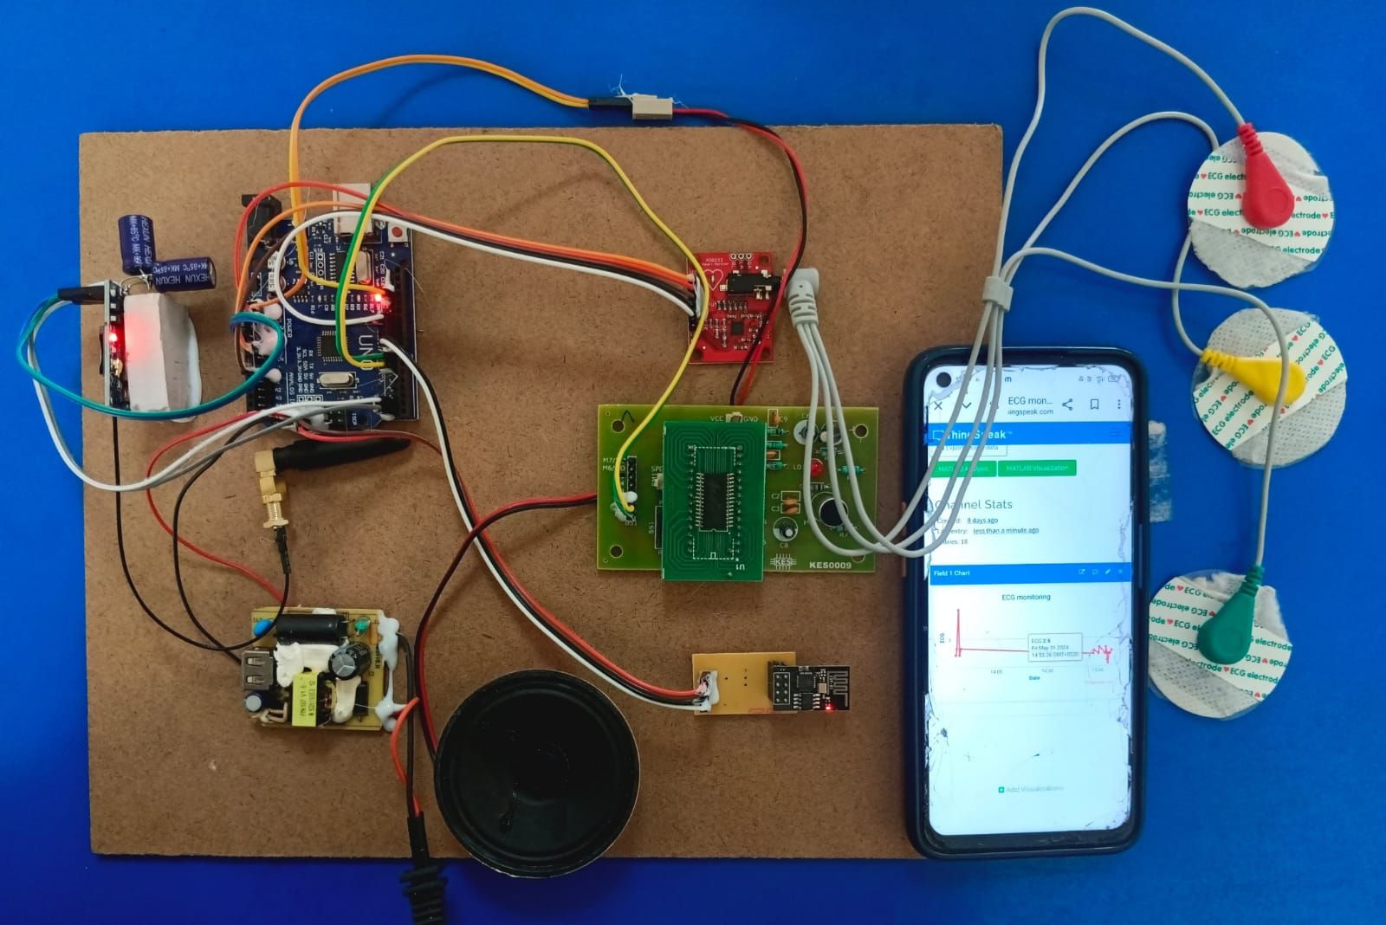
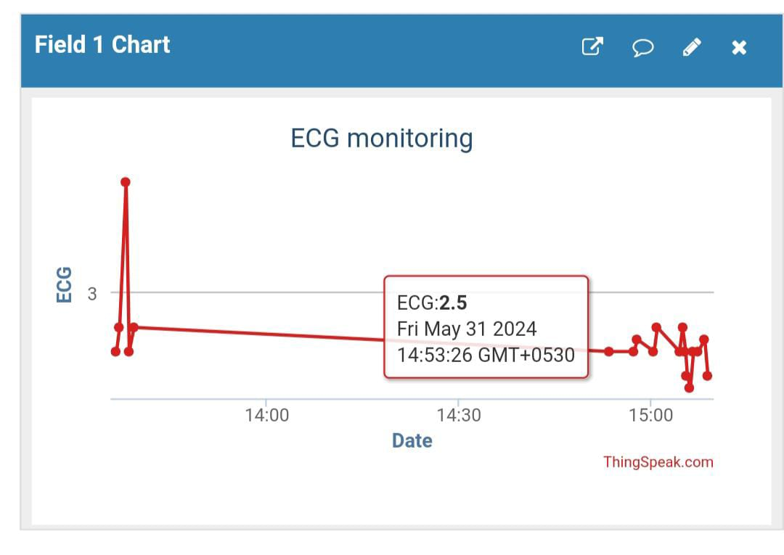
RESULTS
Fig10: ECG monitoring graph with data and time
Fig9: Hardware Kit

Slide 24
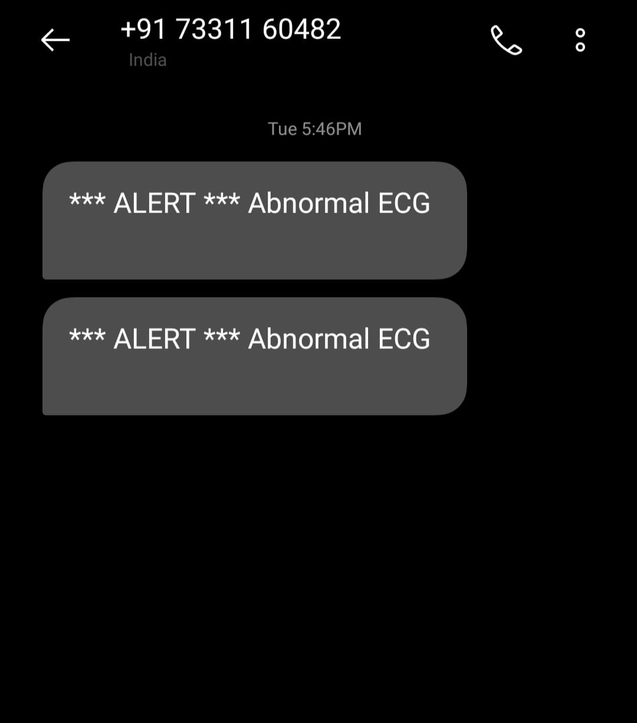
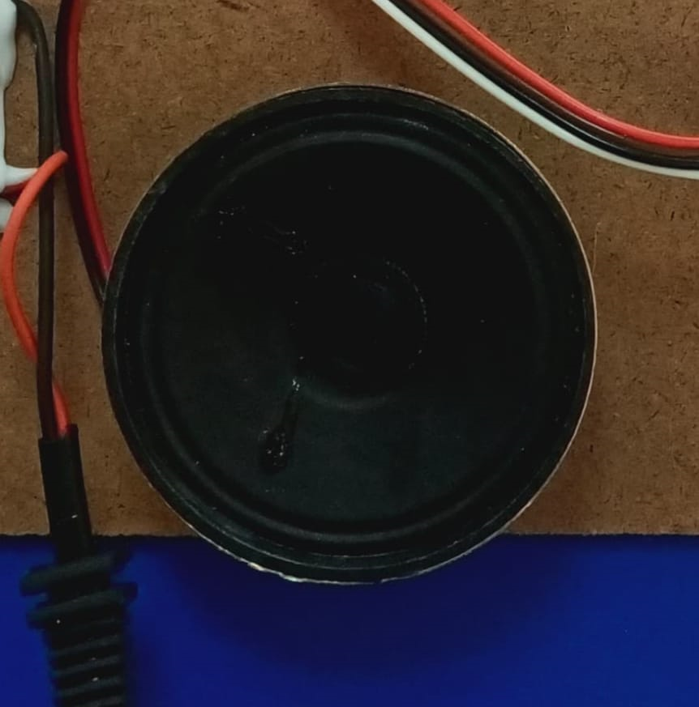
Fig11:Voice alert from Speaker
Fig12:SMS alert for the predefined mobile number

Slide 25
CONCLUSION
ECG probes measures the heart rate in the form of electrical signals. All these electrical signals are fed to the ARDUINO.
As a result in this project ,Arduino continuously read the data from ECG sensor and it will be uploaded in to the thingspeak cloud along with date and time.
When the system detects any abnormal condition, it will send the alert SMS to the predefine mobile number via GSM and also it will give the voice alert through speaker

Slide 26
FUTURE SCOPE
The project can be extended by adding blood pressure measuring,sugar levels of the person etc.
This project can also be extended by using GPRS and 3G technologies.
Video Link
https://photos.app.goo.gl/BphK2gezqNimAWT66

Slide 27
REFERENCES
Mohamed Elhosen, Gustavo Ramírez-González, Osama M. Abu-Elnasar , Shihab A. Shawkat, Arunkumar N, Ahmed farouk “Secure Medical Data Transmission Model for IoTbased Healthcare Systems” IEEE2018
Ashutosh Sharma, Geetanjali Rathee, Rajiv Kumar, Hemraj Saini, Vijayakumar Varadarajan, Yunyoung Nam and Naveen Chilamkurti “A Secure, Energy- and SLA-Efficient (SESE) E-Healthcare Framework for Quickest Data Transmission Using Cyber-Physical System”MDPI2019.
Sarada Prasad Gochhayat, Chhagan Lal, Lokesh Sharma, D. P. Sharma, Deepak Gupta, Jose Antonio Marmolejo Saucedo, Utku Kose “Reliable and secure data transfer in IoT networks”Springer2019.

Slide 28
4.Mamoona Humayun, NZ Jhanjhi, Malak Z Alamri “IoT-based Secure and Energy
Efficient scheme for E-health applications” Science and Technology2020.
5.Sohit Agarwal 1 , Devashish Dasaya “IoT-Based ECG Monitoring System for Health
Care Applications” Mathematical Statistician and Engineering Applications 2022
6. Electronics for you [2024]

Slide 29
THANK YOU

